Slide 1

AspireX
A Web-Based Platform to Connect Students with Mentors for Career Guidance
Harsh Chauhan | Registration No. 12319734
Lovely Professional University, Punjab
Summer PEP 2025

Slide 2

The Mentorship Gap
The Challenge
The Vision
Students today face a critical disconnect between academic learning and real-world career guidance. Traditional mentorship systems are often:
AspireX bridges this gap by creating a structured, accessible digital ecosystem where students can connect with industry experts, receive personalized career guidance, and build meaningful professional relationships that shape their future.
Unstructured and difficult to access
Limited by geographical constraints
Lacking transparency in expertise
Expensive or unavailable to most students

Slide 3




Project Objectives
Full-Stack Development
Authentication System
Build a secure, scalable web application using React for the frontend and Django for robust backend architecture.
Implement dual authentication methods including Google OAuth and traditional email/password for maximum accessibility.
Dual Dashboards
Booking & Feedback
Create distinct, feature-rich dashboards for students and mentors with role-specific functionalities.
Enable seamless service booking, community engagement, and comprehensive feedback mechanisms.

Slide 4




Market Analysis
We analyzed leading platforms to identify gaps and opportunities in the mentorship space:
LinkedIn
MentorCruise
Fiverr
Strengths: Massive network, professional credibility
Strengths: Dedicated mentorship focus, quality mentors
Strengths: Service marketplace model, diverse offerings
Weaknesses: Lacks structured mentorship, overwhelming for students
Weaknesses: Premium pricing, limited free access
Weaknesses: Not education-focused, inconsistent quality
AspireX Advantage: We combine the best of all platforms—structured mentorship, affordable access, service marketplace flexibility, and student-centric design—creating a unique niche in the career guidance ecosystem.

Slide 5






Technology Stack
Frontend
Backend
React JSX with component-based architecture, Context API for state management, and React Router for navigation.
Django Framework with RESTful API design, secure authentication middleware, and robust data validation.
Database
Deployment
Supabase (PostgreSQL) for scalable, real-time data management with built-in authentication support.
Vercel for frontend hosting, Render/Heroku for backend services with CI/CD integration.
Development Tools
GitHub for version control, Postman for API testing, VS Code as primary IDE.

Slide 6
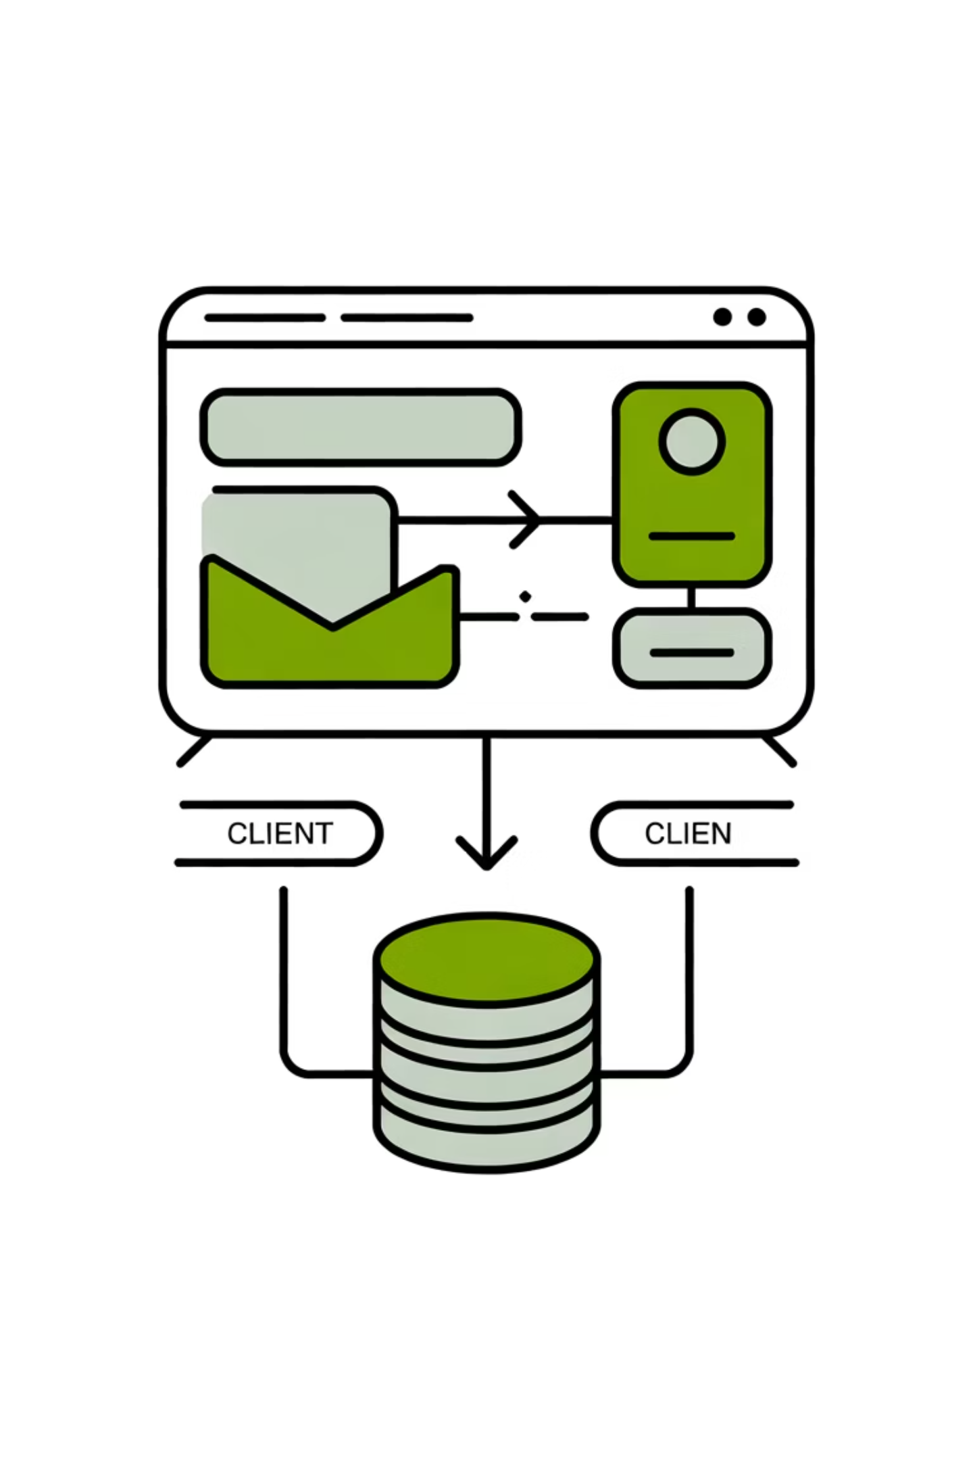




System Architecture
Client Layer
React-based responsive UI with component hierarchy and state management
API Gateway
RESTful endpoints handling authentication, data operations, and business logic
Server Layer
Django backend with models, views, and serializers for data processing
Data Layer
PostgreSQL database with normalized schema for users, services, and transactions
Database Schema: Core entities include Users (authentication), Profiles (student/mentor details), Posts (community content), Services (mentor offerings), Bookings (transactions), and Feedback (ratings & reviews).

Slide 7
Core Platform Features
Service Management
Booking Workflow
Community Hub
Mentors create, edit, and manage service offerings with pricing, descriptions, and availability settings.
Students browse services, schedule sessions, and complete secure payment transactions seamlessly.
Users share insights, ask questions, and engage through posts with likes, comments, and interactions.
💬 Chat System
⭐ Feedback Module
💰 Earnings Dashboard
Real-time messaging between students and mentors
Comprehensive rating and review system for quality assurance
Mentors track income, bookings, and performance analytics

Slide 8

User Experience Design
01
Mobile-First Approach
Responsive design ensures optimal experience across devices, from smartphones to desktops, prioritizing accessibility.
02
Component Architecture
Reusable React components create consistent UI patterns, improving maintainability and development efficiency.
03
Intuitive Navigation
React Router enables smooth transitions between pages with dynamic routing and protected routes for authenticated users.
04
State Management
Context API provides centralized authentication state and user data across the application without prop drilling.

Slide 9
Development Journey
Testing & Quality Assurance
Agile Methodology
Unit Testing: Component-level testing for individual functions
Sprint 1: Foundation
1
Integration Testing: API endpoint validation and data flow verification
Manual Testing: User journey testing across different scenarios
Project setup, authentication, and basic UI components
CI/CD Pipeline: Automated deployment with Vercel for continuous integration
2
Sprint 2: Core Features
Challenges Overcome
Service management, booking system, and user profiles
Sprint 3: Community
3
Resolved CORS configuration issues between frontend and backend
Integrated Google OAuth with custom authentication system
Posts, interactions, chat system, and notifications
Optimized database queries for performance
4
Sprint 4: Polish
Testing, bug fixes, deployment, and documentation
Version Control: Git branching strategy with main (production), develop (integration), and feature branches for organized collaboration.

Slide 10




Results & Future Vision
2
100%
5
User Roles
Deployment Success
Core Modules
Student and Mentor dashboards with distinct features
Fully functional and accessible application
Authentication, services, booking, community, and feedback
Live Application
Future Enhancements
Website: aspire-x.vercel.app
Real-Time Chat
Source Code: github.com/harshchauhan01/AspireX
WebSocket integration for instant messaging
Key Achievements
Secure, scalable full-stack architecture
Payment Integration
Professional-grade user experience
Stripe/PayPal for secure transactions
Complete end-to-end functionality
Production-ready deployment
AI Matching
Intelligent mentor-student pairing algorithm
Native Apps
iOS and Android mobile applications
"This project transformed my understanding of full-stack development, teaching me not just technical skills, but how to build products that solve real problems and create meaningful connections between people."

Slide 11
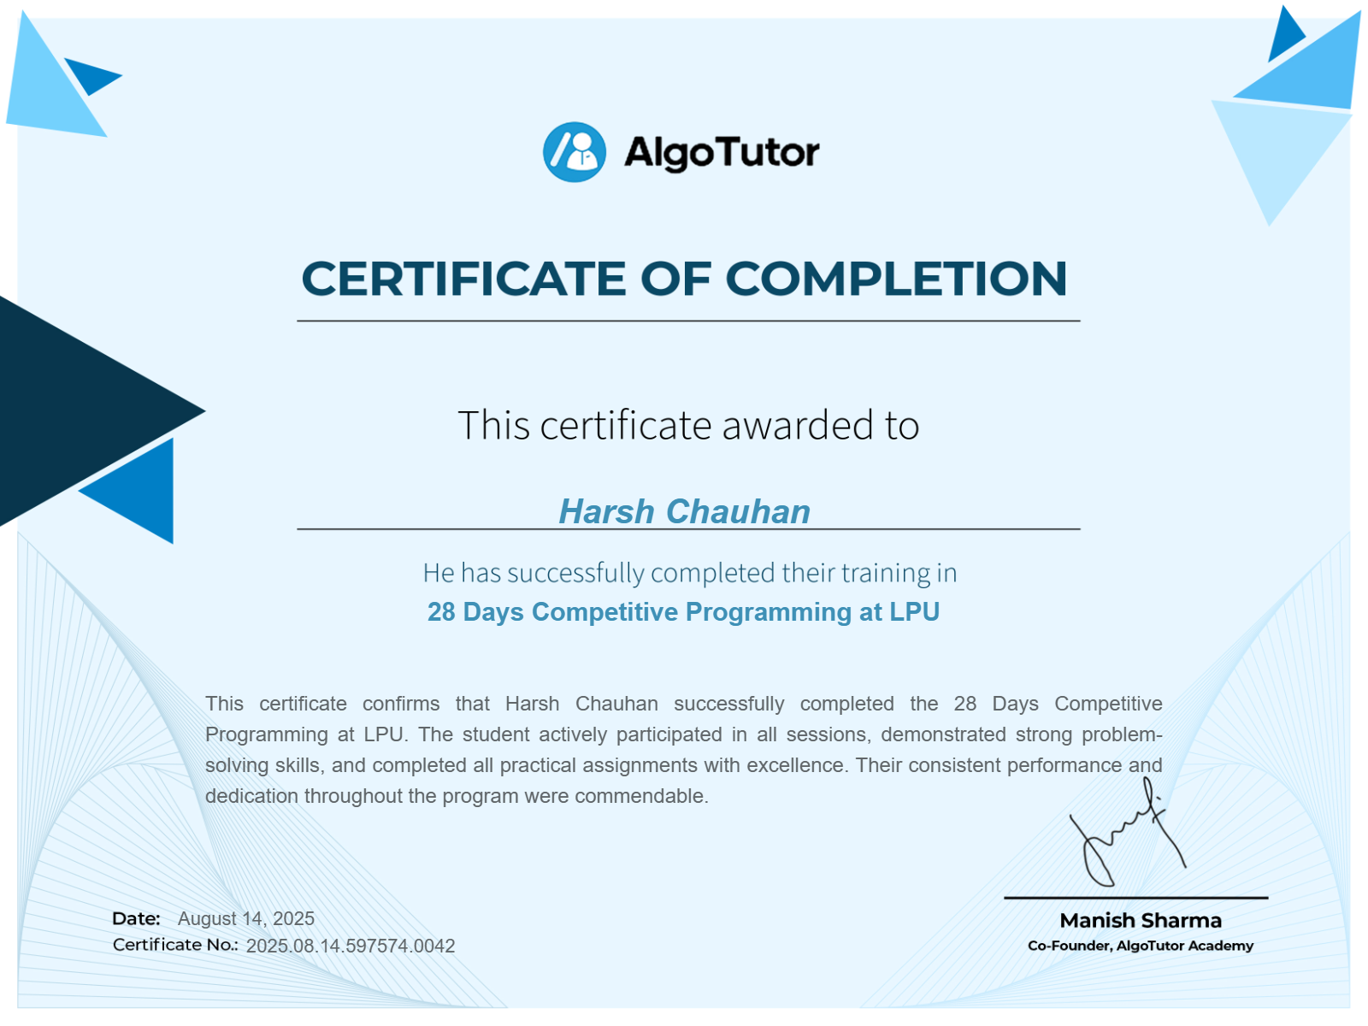
Certificate of Completion

